Slide 1

FLE
Field Level Encryption

Slide 2

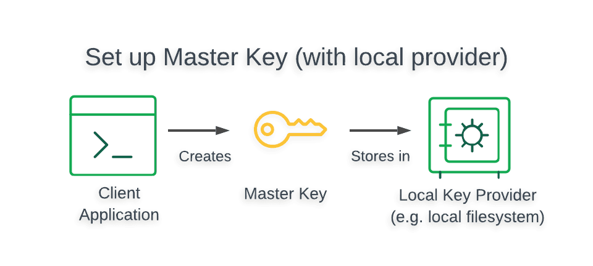
Setup Master Key
The Local Key Provider is not suitable for production.
The Local Key Provider is an insecure method of storage and is therefore not recommended if you plan to use CSFLE in production. Instead, you should configure a master key in a Key Management System (KMS) which stores and decrypts your data encryption keys remotely.

Slide 3
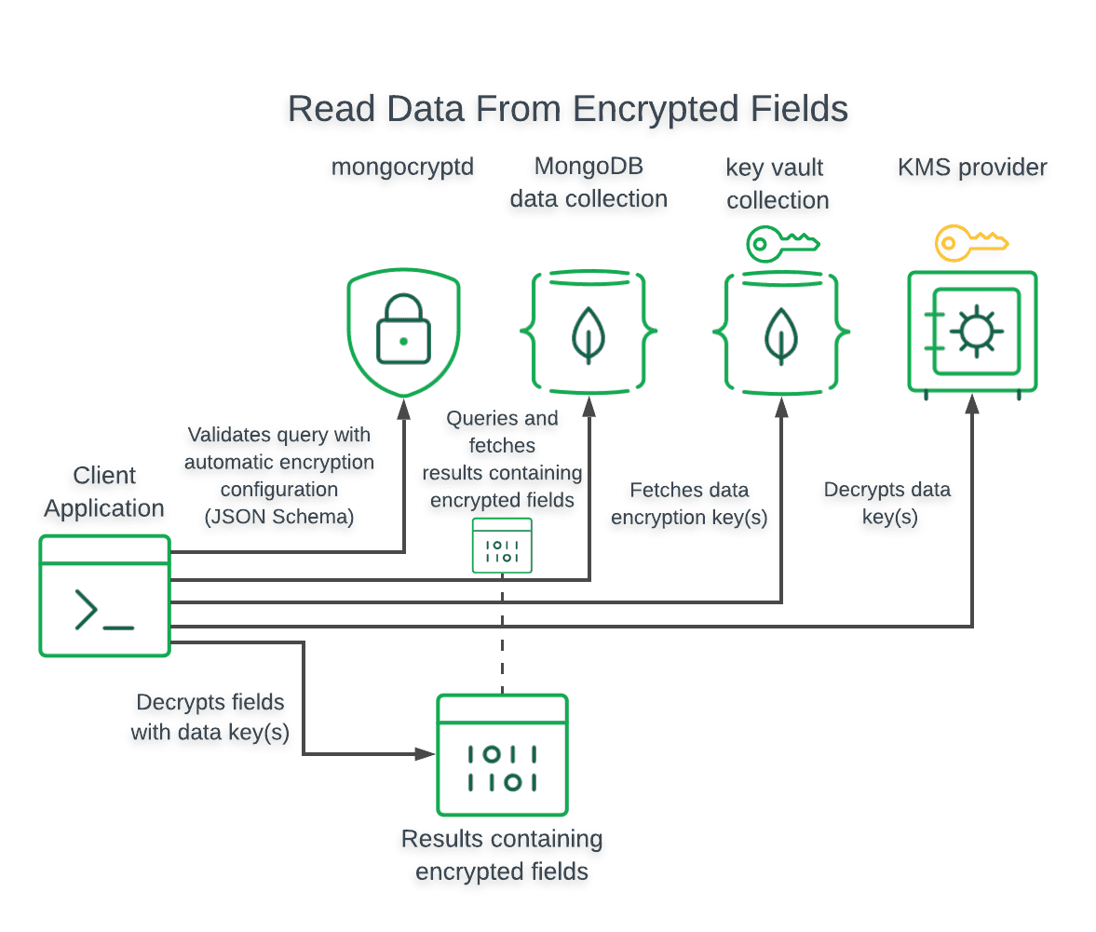
Querying
The following diagram shows the steps taken by the client application and driver to query and decrypt field-level encrypted data.

Slide 4
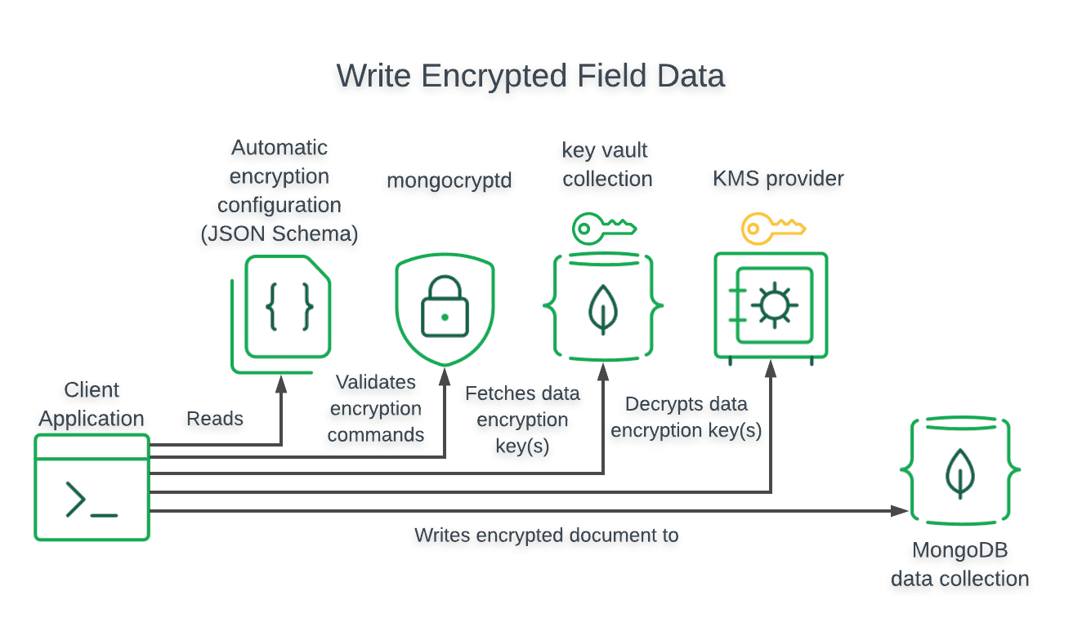
Inserting
The following diagram shows the steps taken by the client application and driver to perform a write of field-level encrypted data

Slide 5






When Backend Starts
BE gets Master Key from KMS.
BE will get Encrypted Data key from Key Vault Collection. It has to decrypt this key with the Master Key.
BE gets JSON Schema from Schema Collection.
App Collection
Saving/Updating
FE makes a API call to save/update.
BE will check the {Json Schema} which field to encrypt with the Data key.
The payload with encrypted columns are stored in App Collection.
FE
Key Vault Collection
BE
Encrypted Data Key
Master Key
Querying
FE makes a API call to query
Get data from App Collection.
BE will check the {Json Schema} which field to decrypt with the Data key
The payload with the decrypted columns is send to FE
Schema Collection
{Json Schema}
KMS

Slide 6
References
https://www.mongodb.com/developer/languages/python/python-quickstart-fle/
https://www.mongodb.com/developer/languages/javascript/client-side-field-level-encryption-csfle-mongodb-node/

Slide 7
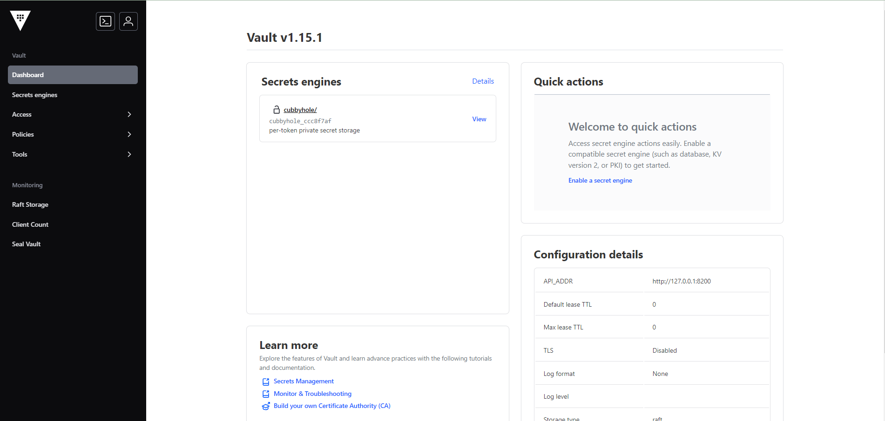
Hashicorp Vault

